Slide 1
Advanced Intelligent Textile Spinning Machine Monitoring, Fault Diagnosis and Condition-Based Maintenance System
An Arduino-Based Embedded Monitoring Prototype with Fault Prioritization
TEAM MEMBERS
Bharanidaran S - CB.SC.U4CSE25609
Dharshan S - CB.SC.U4CSE25614
Saswin S K - CB.SC.U4CSE25652
Harish Karthic U- CB.SC.U4CSE25659

Slide 2
1 Why Monitor a Textile Spinning Machine?
Temperature
Vibration
Electrical
Abnormal temperature can indicate an operating problem
Abnormal vibration can indicate a condition requiring inspection
Electrical variations can indicate abnormal operation
Yarn
Package
Yarn-break events can interrupt production
Package-low events can interrupt production
Textile spinning machines operate continuously.
Rotating spindle assemblies are continuously involved in operation.
Continuous operation requires continuous condition monitoring.

Slide 3
2 Problem Statement
“Abnormal machine conditions and production interruptions need to be identified, prioritized and recorded systematically to support timely inspection and reduce untracked downtime.”
1 Detection
2 Prioritization
3 Tracking
Identify abnormal machine conditions.
Determine which fault requires attention first.
Maintain recent readings and event information.
EXISTING CHALLENGES
Faults may require manual observation.
Multiple notifications may not be equally urgent.
Event history can be difficult to track consistently.

Slide 4
3 Proposed Solution
Machine
Conditions
Sensor / Event
Inputs
Arduino
Mega 2560
Rule-Based
Detection
Circular Buffer
+ Priority Queue
Machine State
& Alerts
THE PROTOTYPE
•
Monitors selected machine conditions.
•
Detects configured abnormal conditions.
•
Prioritizes selected fault notifications.
•
Displays operating state and alerts.
•
Maintains recent readings and supported event records.
An educational prototype — not a complete industrial control system.

Slide 5
4 Project Objectives & Scope
OBJECTIVES
•
Monitor selected temperature, acceleration and electrical readings.
•
Detect configured abnormal conditions.
•
Prioritize selected fault notifications.
•
Display operating state and alerts.
•
Maintain recent readings and supported event records.
IN SCOPE
OUT OF SCOPE
•
Arduino-based prototype
•
Validated machine-learning prediction
•
Wokwi environment
•
Independent physical sensing for all five stations
•
Five software-modeled spindle stations
•
Guaranteed automatic industrial protection
•
Rule-based detection
•
Certified industrial deployment
•
Local displays and alerts
•
Circular Buffer
•
Priority Queue

Slide 6
5 System Architecture
INPUTS
CONTROLLER
SOFTWARE PROCESSING
OUTPUTS
•
DS18B20 Temperature Sensor
Arduino Mega 2560
•
SSD1306 OLED
•
Input acquisition
•
Serial Monitor
•
MPU6050 Accelerometer
•
Data updates
•
Green LED
•
Threshold checks
•
Yellow LED
•
INA219 Voltage/Current Monitor
•
Circular Buffer
•
Red LED
•
Rule-based detection
•
Buzzer
•
Priority Queue
•
Optional microSD
•
Rotary Encoder
•
Machine-state tracking
•
Yarn-Break Button
•
Package-Low Button
•
Statistics updates
•
Alarm Acknowledge Button

Slide 7
6 Hardware Components
Component | Function | Project Use
Arduino Mega 2560 | Main controller | Coordinates acquisition, logic and outputs
MPU6050 | Accelerometer | Provides acceleration data as vibration indicator
INA219 | Power monitor | Measures voltage and current
DS18B20 | Temperature sensor | Measures operational temperature
Rotary Encoder | Input device | Adjusts target value and navigation
SSD1306 OLED | Display | Machine-status interface
LEDs & Buzzer | Indicators | Visual and audible alerts
Push Buttons | Simulated inputs | Yarn-break, package-low, alarm acknowledgement

Slide 8
7 How the System Works
Start Monitoring Cycle
Abnormal Condition?
NO
YES
Acquire Sensor Readings
Continue Monitoring
Create Fault Event
Insert into Priority Queue
Update Circular Buffer
Process Highest Priority
Update Machine State & Alarms
Evaluate Rules
Refresh OLED / Serial Monitor
Update History
After the history update, the cycle returns to Start Monitoring Cycle.

Slide 9
8 Fault Detection & Machine States
NORMAL
WARNING
CRITICAL
Readings within configured limits
Examples:
Examples:
•
Abnormal temperature
•
Abnormal vibration
•
Electrical out-of-range
•
Yarn-break event
Output: Green LED
•
Package-low event
•
Configured critical condition
Output: Yellow LED
Output: Red LED + Buzzer
Alarm acknowledgement indicates that the operator has seen the alert; it does not automatically resolve the underlying fault.

Slide 10
9 Circular Buffer
Recent sensor readings need to be maintained efficiently.
New sensor sample arrives. Store at current write position. Advance write position. Wrap around at the end. Overwrite the oldest sample when full.
BEFORE (FULL)
AFTER
31
32
33
34
35
36
32
33
34
35
new value 36 arrives — write pointer at slot 0 (oldest = 31)
write pointer advances to slot 1; after slot 4 it wraps to slot 0
Fixed memory usage
No array shifting
Rolling / recent calculations
Insertion: O(1)

Slide 11
10 Priority Queue Using Max Heap
Critical Vibration Priority 3
Example max-heap: the highest-priority event sits at the root.
The system does not necessarily process events in the order they arrive. Instead, it selects the event with the highest assigned priority.
Over-Temperature Warning Priority 2
Package-Low Event Priority 1
COMPLEXITY: INSERT
COMPLEXITY: REMOVE HIGHEST PRIORITY
COMPLEXITY: VIEW HIGHEST PRIORITY
O(log n)
O(log n)
O(1)
These are example software priorities, not measured risk values.

Slide 12
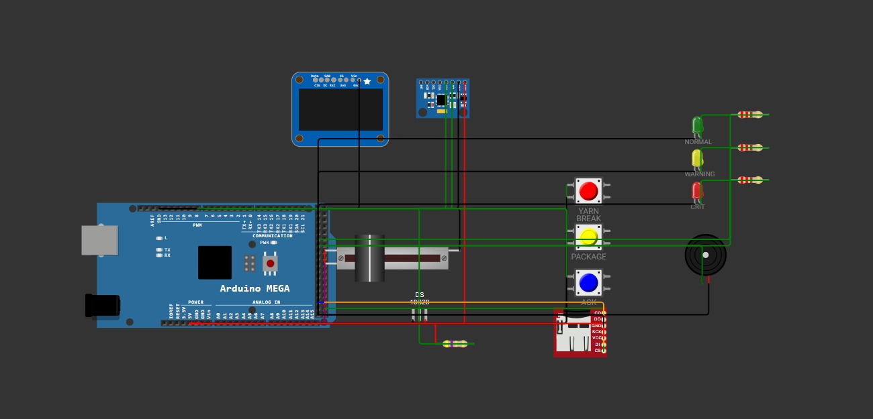
11 Circuit Design & Simulation
[Insert Wokwi circuit screenshot here]
Arduino Mega 2560 · MPU6050 · INA219 · DS18B20 · OLED · Rotary encoder · Push buttons · LEDs · Buzzer
COMMUNICATION INTERFACES
I²COLED, MPU6050, INA219
OneWireDS18B20
Digital inputsEncoder and buttons
Digital outputsLEDs and buzzer
SPIOptional microSD

Slide 13
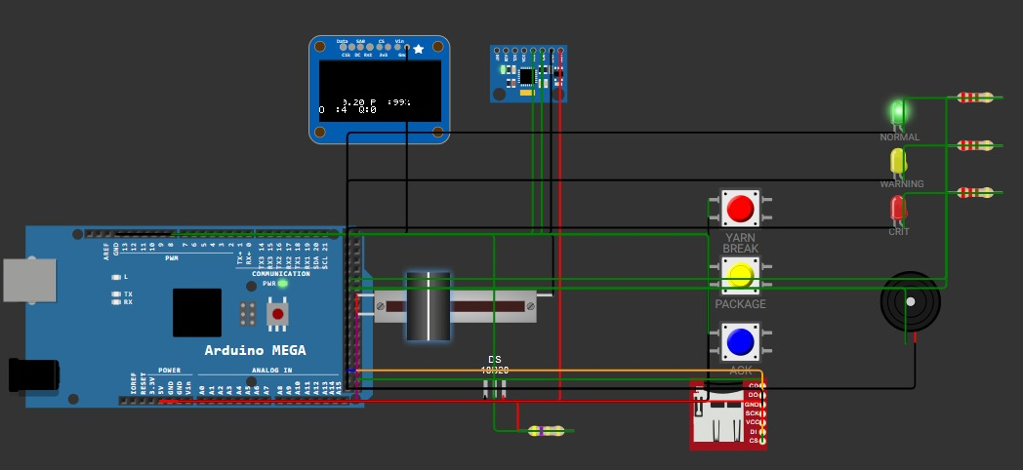
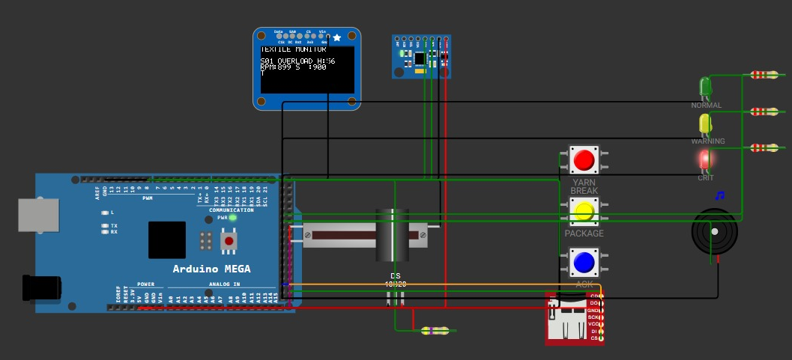
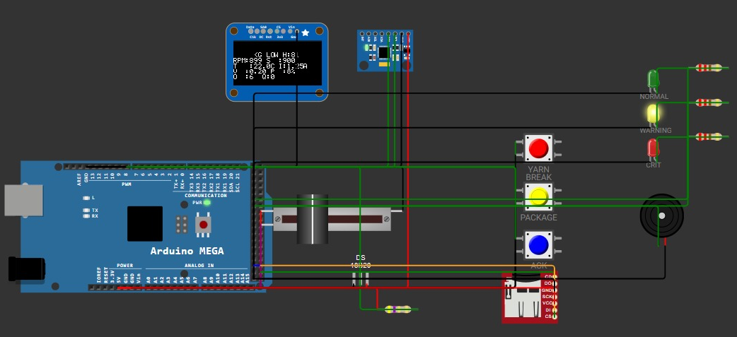
12 Simulation Working & Example Scenarios
Scenario 1 — NORMAL
Scenario 2 — WARNING
Scenario 3 — CRITICAL
Input within limits
Threshold crossed
Critical condition / simulated fault
→ Normal state
→ Warning event
→ High-priority event
→ Green LED
→ Yellow LED
→ Red LED + Buzzer
[Wokwi screenshot]
[Wokwi screenshot]
[Wokwi screenshot]
Yarn-break → Critical alert Package-low → Warning alert

Slide 14
13 Testing, Limitations & Future Improvements
TEST CASES
CURRENT LIMITATIONS
FUTURE IMPROVEMENTS
•
Normal input
•
Five spindle stations are software-simulated
•
Actual RPM measurement sensor
•
Temperature threshold
•
Vibration threshold
•
Rotary encoder is a setpoint control, not an RPM sensor
•
Independent physical sensors for individual spindle stations
•
Yarn-break
•
Package-low
•
Vibration analysis is simplified
•
Real-machine measurements
•
Multiple events
•
Electrical measurements require calibration
•
Calibrated thresholds
•
Buffer wraparound
•
Queue selection
•
Thresholds are rule-based
•
Alarm acknowledgement
•
microSD requires simulator compatibility testing
•
microSD logging

Slide 15
14 Conclusion
INPUTS
ARDUINO
DETECTION
BUFFER + QUEUE
FAULT PRIORITIZATION
ALERTS
The prototype demonstrates embedded monitoring of selected machine conditions.
Rule-based logic identifies configured warnings and simulated fault events.
Circular Buffer stores recent readings efficiently.
Binary Heap Priority Queue prioritizes pending notifications.
Embedded systems and data structures can work together for condition monitoring.
“The system is an educational monitoring prototype. Real-machine deployment would require additional sensing, calibration, validation and appropriate industrial safety engineering.”
THANK YOU

